Slide 1
Seat expansion project

Slide 2
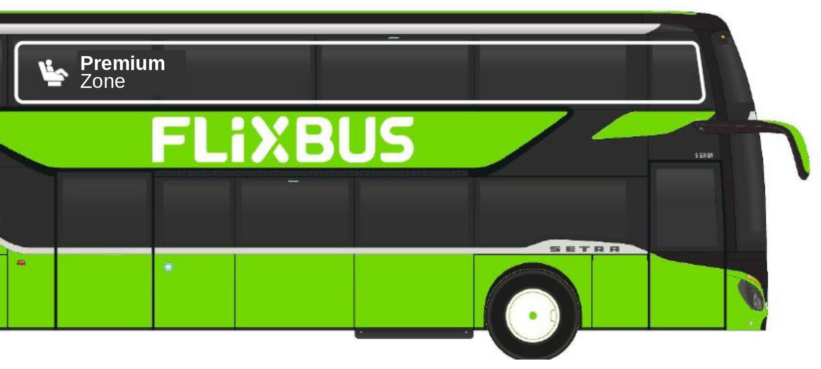
Bus Design – Comfort+ Seats
DESIGN DRAFT
The frame highlights the area as something special
The frame sets the area apart from other seats on the bus
The seat icon and Premium Zone work well as a logo composition
EVALUATED & REJECTED
✕ Seat focus Focusing only on the seat i.e. with an icon doesn’t work as it is hard to show the advantage / differentiate vs. a standard bus seat
✕ Add on to FlixBus i.e. FlixBus+, FlixBus Blackline -> It is not an upgrade on the whole bus; it concerns only some seats on this bus. No sub brand recommended for now.
Notes:
In general: Bus is not ideal as key communication channel → can drive awareness but needs to work via booking funnel, campaign,…

Slide 3
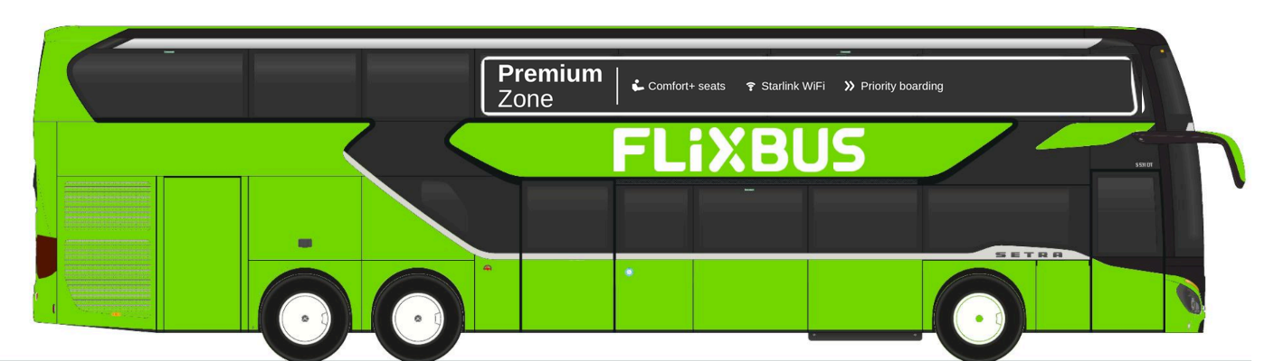
Bus Design - Premium Zone as a holistic concept out of which Comfort+ Seats are one feature
DESIGN DRAFT
Brief Creative –
re-work & to prepare as template → DONE
Better WiFi (stability of the system)
Review if we go with Comfort+
More Comfort – Better WiFi – Early Boarding

Slide 4
The Premium Zone is the holistic concept & experience. However, in the end, consumers need to select a product during booking.
 | CONCEPT | PRODUCT
Name | Premium Zone | Comfort+ Seat
JTBD | Awareness & Consideration | Conversion
What to sell | Experience & Service | Product & Features
Where to communicate | Communication campaign, media assets, PR / coms, landing page, newsletter, | Booking funnel
Benefit | More premium bus travel | More comfort
RTB | Comfort+ seats, Starlink WiFi, Priority Boarding, separated area | More legspace, adjustable headrest, 2+1 seating, increased recline, leg and thigh rests

Slide 5
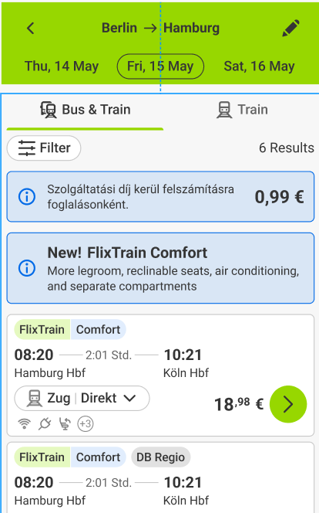
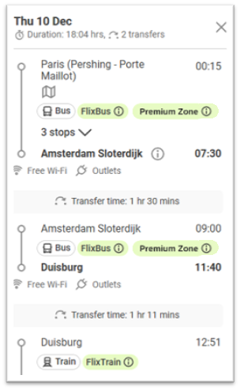

Booking Funnel
WORK IN PROGRESS
Add train fleet figma
Can we show Premium Zone like this and include “i” info?
Premium Zone available on this ride: Find the Premium Zone separated in the front of the upper level of the bus. Enjoy the Comfort+ seat, Starlink WiFi, priority boarding and more privacy.
What to check if we call the seat Comfort+
1 Area and seat are two separate labels
2 “Premium” never describes the seat
3 Comfort+ is named at every step where the traveler pays or confirms

Slide 6
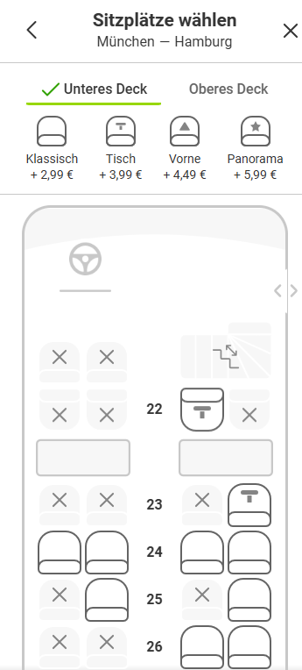
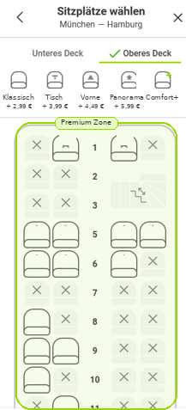
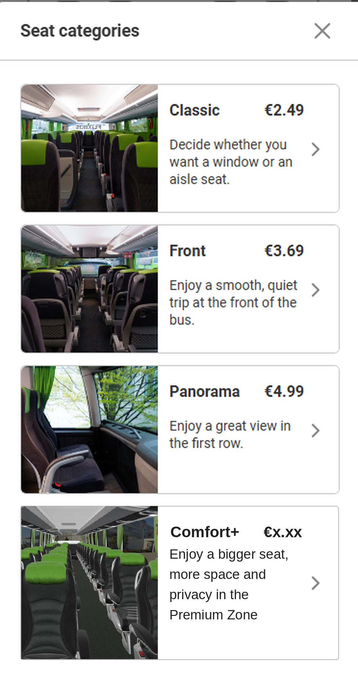
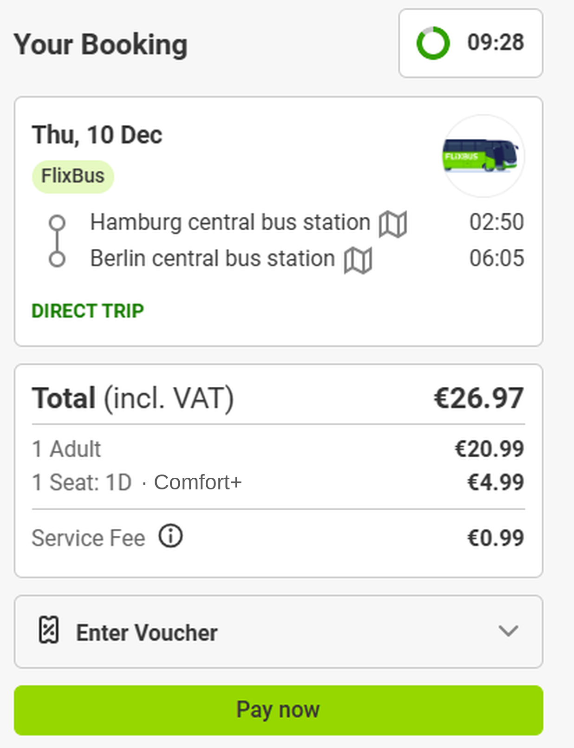
Booking Funnel
3 routes discussed
Seat is “just another seat to book” next to the others → would need to call it Premium
Lower Deck – Upper Deck – Premium Zone → Comfort+ seat can sit in Premium Zone (only 2 seat types would be included here: Comfort+ Single & Comfort+ Double)
Highlight the Premium Zone when the “Upper Deck” tab is selected → Comfort+ seat can sit in Premium Zone
WORK IN PROGRESS
Only 3 seat rows in upper deck Premium Zone
Does a person book a seat or the zone?
Can we highlight Premium Zone? It only makes sense to call the seat comfort+ if we can highlight the Premium Zone.
If we are already in upper deck – can we only show Comfort+ Single / Double (in the front) and Classic Seats (in the back)?
2
3
1

Slide 7
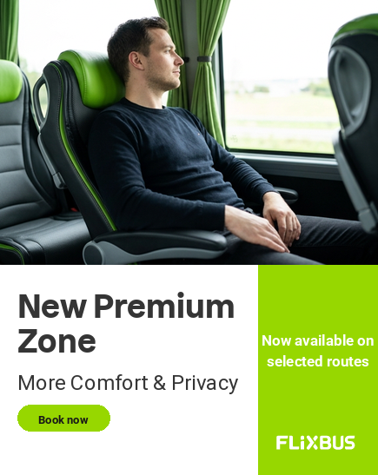
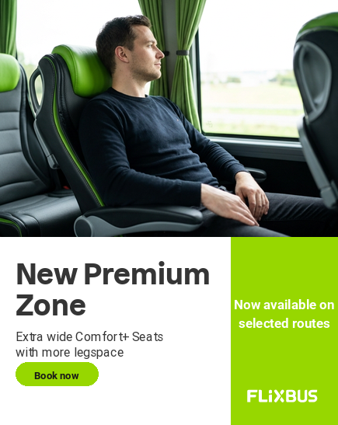


Asset & Messaging Example
DESIGN DRAFT
More Comfort & Privacy
Extra wide Comfort+ Seats
with more legroom
Better WiFi & Priority Boarding included
Notes:
Can we put pre selected routes in booking funnel of the landing page?
Can we filter for “Premium Zone”?

Slide 8
The hierarchy with Comfort+
FlixTrain
Classic
Comfort
Star
Regular
Xtra
Legspace
Table
Family Area
Xtra
Classic
Legspace
Table
Premium
FlixBus
Premium
Comfort+
Classic
Classic
Front
Panorama
Regular
Single
Regular
Double
Types
Areas
Seat categories

Slide 9
We recommend launching the new seat category as “Comfort+”
ALIGNED on 08.10.
RECOMMENDATION
Comfort+
IN EVALUATION
~ Premium
Potentially overpromises, but works if talking about the Zone as a package with extra add–ons (e.g. better seat, priority boarding, faster wi-fi)
“A bigger seat, more space and privacy — enjoy the exclusive Comfort+ Zone.”
WHY IT WORKS
Self-explanatory — needs no icon or sub-line to be understood
Fits the FlixBus family & FlixTrain tiers (Classic · Comfort · Star)
Short & language-proof — app, booking funnel, bus exterior
“+” signals an upgrade without implying today’s seats fall short
REJECTED
✕ Business
Airline- & rail-coded and very corporate; off-brand; bus is not a traditional business travel mode
✕ Xtra (like for Train)
Xtra as stand-alone does not work well, as it is more than just more leg-space or a table
Notes:
Premium area in FlixTrain Star model > we are competing with our seats in the mid tier (not premium tier)
Xtra > it is more than just xtra (legspace), it is more comfortable; Xtra for train is also in “regular” area – this is not “only” Xtra, younger vs. premium

Slide 10
Preferred Design Route communicates Premium Zone on the bus
ALIGNED 08.10.
The frame highlights the area as something special
The frame sets the area apart from other seats on the bus
The seat icon and Premium Zone work well as a logo composition
EVALUATED & REJECTED
✕ Seat focus Focusing only on the seat i.e. with an icon doesn’t work as it is hard to show the advantage / differentiate vs. a standard bus seat
✕ Add on to FlixBus i.e. FlixBus+, FlixBus Blackline -> It is not an upgrade on the whole bus; it concerns only some seats on this bus. No sub brand recommended for now.
Notes:
In general: Bus is not ideal as key communication channel → can drive awareness but needs to work via booking funnel, campaign,…

Slide 11
What do other (transportation) brands call their seat categories?
Different names exist for more elevated seating types.
 | Standard Tier – Standard – | Mid Tier – Comfort / Plus / Premium – | Premium Tier – 1st Class / Business –
Train | DB: 2. Klasse FlixTrain: Standard Eurostar: Standard SNCF: 2nde classe OUIGO: Standard Trenitalia: Standard | DB: BahnComfort FlixTrain: Xtra Eurostar: Plus Trenitalia: Premium | DB: 1. Klasse SNCF: 1ère classe Eurostar: Premier Trenitalia: Business, Executive
Bus | FlixBus: Classic Itabus: Comfort ALSA: Comfort Regiojet: Standard | FlixBus: Front, Panorama Itabus: Top ALSA: Supra Regiojet: Relax
Plane | LH: Economy Eurowings: Basic Ryanair: Basic / Regular easyJet: Standard | LH: Premium Economy Eurowings: Smart Ryanair: Plus easyJet: Standard Plus | LH: Business / First Eurowings: BIZ
Out-of-Box | Cinema: Standard Ferry/Cruise: Standard / Deck Theater: Standard | Cinema: Comfort / Love Seat Ferry: Comfort Theater: Premium | Cinema: VIP / Premium Lounge Cruise: Lounge / Cabin Theater: Box / Stall / Balcony
Notes:
The vocabulary is crowded and inconsistent

Slide 12
Comfort, Plus and Premium re-occur most.
Standard
Comfort
Regular
2. Klasse
Panorama
Plus
Economy
Premium
Basic
Premier
Xtra
Classic
Business
Lounge
1. Klasse
Front
Executive
2nde classe
Smart
Top
Supra
BahnComfort
1ère classe
First
BIZ
Deck
Love Seat
VIP
Cabin
Box
Stall
Balcony

Slide 13
Timeline
20.08.2026
Seat design fixed (fabric, colour,…)
08.10.2026
Seat naming fixed
30.11.2026
Bus branding fixed - Foiling / Exterior
Jan 2027
Bus delivery
May 2027
First rides
Mar/Apr 2027
Audience segmentation
Name approval / re-work
mid Nov
Finalization design & brand elements for bus branding
C-Level approval
end Oct
Campaign brief with Mother
Campaign Pre-Launch Phase (tbd)
Campaign Launch Phase (tbd)

Slide 14
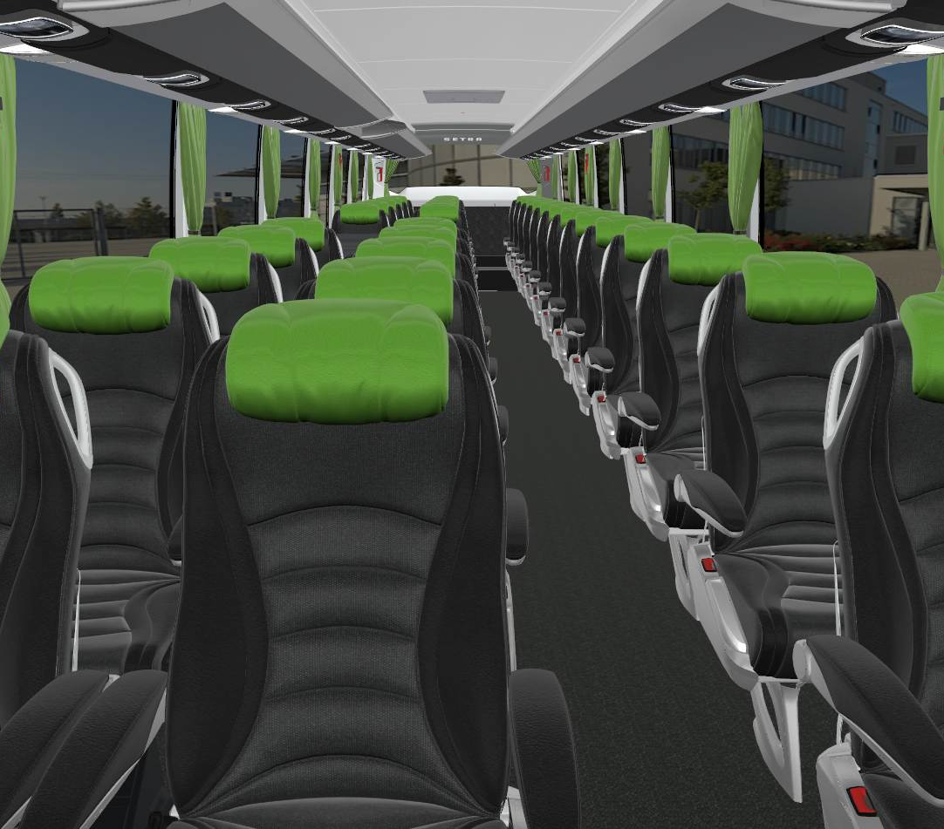
The Comfort+ seat
2+1 seating — more personal space
Leg and thigh rests for the long haul
Generous seat pitch
Increased recline to relax or to work
Adjustable headrest

Slide 15
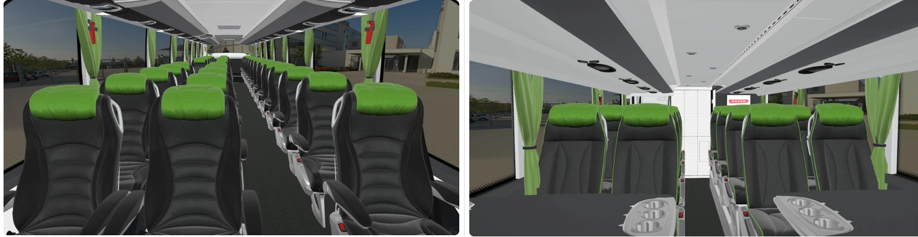
Interior Design
Upper deck 2+1 comfort seating [Umbrella bus] Lower deck standard seating [Umbrella bus]

